Slide 1
CS 6785: Advanced Topics in Machine Learning
Deep Probabilistic
and Generative Models
Volodymyr Kuleshov
Cornell Tech
Spring 2023
URL: https://canvas.cornell.edu/courses/50665

Slide 2
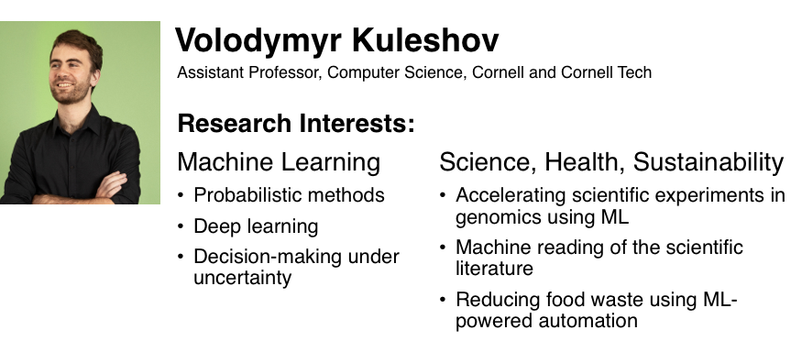

Slide 3




The topic of this course is
Deep Probabilistic and Generative Modeling
Let’s dissect what each term means.

Slide 4
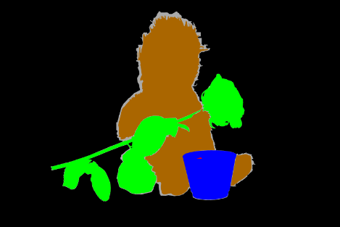
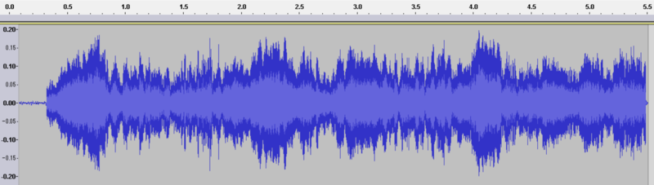
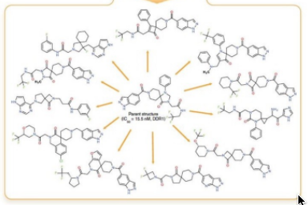

What are Generative Models?
Generative machine learning algorithms model complex, high-dimensional objects.
Human Speech
High-Resolution Images
Paragraphs of Text
Chemical Molecules
Notes:
Problem: making sense of complex, unstructured sensory inputs. Images, speech, text, video, etc.
https://commons.wikimedia.org/wiki/Language#/media/File:Floor_7a_bookstacks_in_Sterling_Memorial_Library.jpg
https://commons.wikimedia.org/wiki/File:EmiMa-099-semantic-segmentation.png
https://commons.wikimedia.org/wiki/File:Waveform_of_Habana_syndrome_sound.png
https://commons.wikimedia.org/w/index.php?title=Special:Search&limit=500&offset=0&ns0=1&ns6=1&ns12=1&ns14=1&ns100=1&ns106=1&search=Autonomous+cars&advancedSearch-current={}

Slide 5
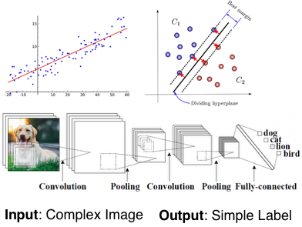
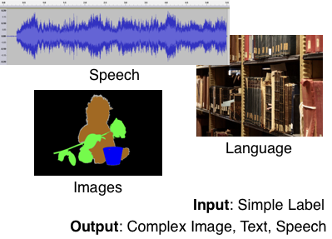
What are Generative Models?
Generative machine learning algorithms model complex, high-dimensional objects.
Discriminative Models
Generative Models
Notes:
Problem: making sense of complex, unstructured sensory inputs. Images, speech, text, video, etc.
https://commons.wikimedia.org/wiki/Language#/media/File:Floor_7a_bookstacks_in_Sterling_Memorial_Library.jpg
https://commons.wikimedia.org/wiki/File:EmiMa-099-semantic-segmentation.png
https://commons.wikimedia.org/wiki/File:Waveform_of_Habana_syndrome_sound.png
https://commons.wikimedia.org/w/index.php?title=Special:Search&limit=500&offset=0&ns0=1&ns6=1&ns12=1&ns14=1&ns100=1&ns106=1&search=Autonomous+cars&advancedSearch-current={}

Slide 6

Discriminative vs. Generative Models
Generative models can do everything that discriminative models can do: e.g., prediction (can get conditional p(y|x) from p(x,y) via Bayes’ rule).
But generative models can also do much more!
Generating new x’s
Conditional generation of p(x|y)
Handling missing inputs in x
And much more!
“A black table with 6 chairs”
Generative Model

Slide 7
Discriminative vs. Generative Models
A generative model can also be used for prediction, because we can derive the conditional p(y|x) from the joint p(x,y) via Bayes’ rule.
A generative model can also do more!
Handling missing inputs in x
Generating new x’s
Conditional generation of p(x|y)
And much more!
P(X= | Caption = “A black table with 6 chairs”)

Slide 8
Generative Modeling: An Example From Computer Graphics and Vision
Our first example of a generation system is a graphics engine that renders 3D shapes from their description. Computer vision algorithms reverse the generative process (a task we call inference).
Abstract Representation
Cube(color=blue, position=, size=, …) Cylinder(color=red, position=, size=,..)
Generation
(graphics engine)
Inference
(vision algorithms)
Renderings of
3D Objects
Mapping between real and abstract representations using generation and inference is a way to reason about complex, structured data.
Notes:
Computer graphics:
Produce plausible images
You choose models, conditions, imging parameters, etc.
Vision:
Given images with noise, estimate physical quantities (ill-posed problem)
Building a generative model is not the entire story. Inference (e.g. vision) is still hard. So not entirely true that if we can create we understand. But it’s a useful step

Slide 9



Generative Modeling: A Statistical & Probabilistic Approach
A graphics engine is specified based on prior knowledge
Cube(color=blue, position=, size=, …)
Cylinder(color=red, position=, size=,..)
Statistical generative models are learned from data.
Image data
(e.g., images of
bedrooms)
Some programmer-defined priors are always necessary, but there is a spectrum:
This course
Graphics
Data
Prior Knowledge
Notes:
We are concerned with statistical generative models
Graphics: purely based on prior knowledge. Difficult to scale. Developing the field took a very long time. Still not entirely solved, active area of research.
Motivation: Reduce the amount of prior knowledge and use data. (machine learning)
Note: cannot do something purely based on data. Known impossibility results. Even in discrete spaces, scaling of sample complexity would be doubly-exponential.
https://www.iconfinder.com/icons/1562699/book_energy_idea_knowledge_icon
https://www.yf.io/p/lsun

Slide 10


Generative Modeling: A Statistical & Probabilistic Approach
How do we specifiy a statistical generative model in practice?
Using probability---by defining a distribution p(x) over the data
A generative modeling algorithm is defined by:
A model: we specify its parametric form (e.g., Gaussian distribution),
A learning objective (e.g., maximum likelihood)
An optimization algorithm, e.g., variational inference, MCMC
Input:
A dataset
(e.g., bedroom images)
& an algorithm
Output:
a probability distribution P( )
probability P(x) of image x
samples x from P
Imputation P(x|y)
…
Notes:
We are concerned with statistical generative models
Graphics: purely based on prior knowledge. Difficult to scale. Developing the field took a very long time. Still not entirely solved, active area of research.
Motivation: Reduce the amount of prior knowledge and use data. (machine learning)
Note: cannot do something purely based on data. Known impossibility results. Even in discrete spaces, scaling of sample complexity would be doubly-exponential.

Slide 11

Generative Modeling: A Statistical & Probabilistic Approach
In the context, of probabilistic generative modeling:
Data: samples from data distribution (e.g., images of bedrooms)
Prior knowledge: parametric form of the model (e.g., Gaussian distribution), objective function (e.g., maximum likelihood), optimization algorithm, etc.
Output:
a probability distribution P( )
probability P(x) of image x
samples x from P
…
Notes:
We are concerned with statistical generative models
Graphics: purely based on prior knowledge. Difficult to scale. Developing the field took a very long time. Still not entirely solved, active area of research.
Motivation: Reduce the amount of prior knowledge and use data. (machine learning)
Note: cannot do something purely based on data. Known impossibility results. Even in discrete spaces, scaling of sample complexity would be doubly-exponential.

Slide 12
Generative Modeling: A Statistical & Probabilistic Approach
In the context, of generative modelng
Data: samples (e.g., images of bedrooms)
Prior knowledge: parametric form (e.g., Gaussian?), loss function (e.g., maximum likelihood?), optimization algorithm, etc.
It is called generative because sampling from p(x) generates new images
A probability distribution
p( )
Image x
probability p(x)
…
Notes:
We are concerned with statistical generative models
Graphics: purely based on prior knowledge. Difficult to scale. Developing the field took a very long time. Still not entirely solved, active area of research.
Motivation: Reduce the amount of prior knowledge and use data. (machine learning)
Note: cannot do something purely based on data. Known impossibility results. Even in discrete spaces, scaling of sample complexity would be doubly-exponential.

Slide 13
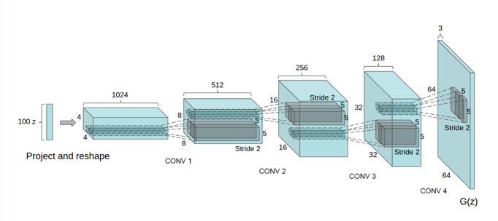
Deep Generative Models
The probability distribution p(x) will be specified using deep neural networks
High-Dimensional
Image
Latent Vector
Representation
Sequence of Convolutional Upsampling Layers
Radford et al.

Slide 14
Deep Probabilistic and Generative Modeling
Next: Applications of Deep Generative Models

Slide 15
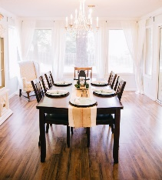








Discriminative vs. Generative Models
Discriminative: classify bedroom vs. dining room
Generative: generate X
Y=B , X=
Y=D , X=
Decision boundary
Y=B , X=
Y=D , X=
…
…
Y=B , X=
Y=D , X=
The input image X is always given. Goal: a good decision boundary, via conditional distribution
Ex: logistic regression, convolutional net, etc.
The input X is not given. Requires a model of the joint distribution
P(Y = Bedroom | X = ) = 0.0001
P(Y = Bedroom , X= ) = 0.0002
Notes:
How is this different from traditional ML?
Y is simple

Slide 16


Discriminative vs. generative
Joint and conditional are related via Bayes Rule:
P(Y = Bedroom, X= )
P(Y = Bedroom | X= ) =
P( X = )
Discriminative: X is always given, does not need to model
P( X= )
Therefore it cannot handle missing data
P(Y = Bedroom | X = )
Notes:
How is this different from traditional ML?
Y is simple

Slide 17
Conditional Generative Models
Class conditional generative models are also possible.
P(X= | Caption = “A black table with 6 chairs”)
Such models are a step towards the controlled generation of complex outputs.
Notes:
Y is simple

Slide 18
Next: Applications of Deep Generative Models

Slide 19

Generative Art
kneeling cat knight, portrait, finely detailed armor, intricate design, silver, silk, cinematic lighting, 4k

Slide 20

Generative Art
A digital illustration of a steampunk flying machine in the sky with cogs and mechanisms, 4k, detailed, trending in artstation, fantasy vivid colors

Slide 21
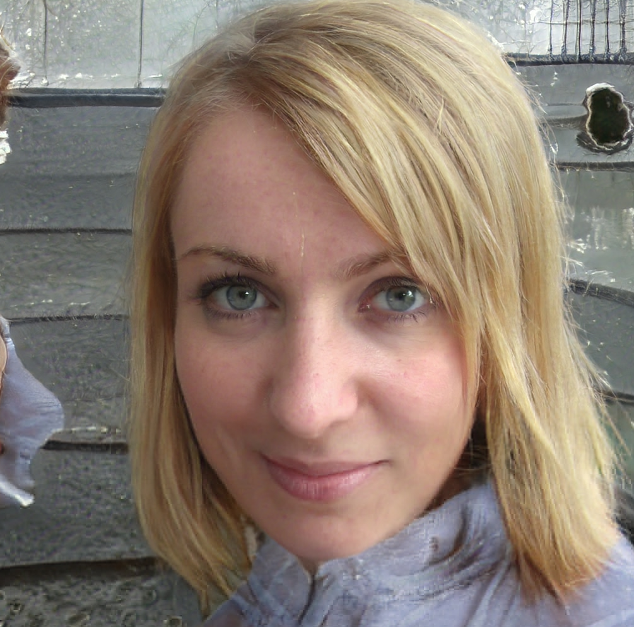


Generating Photorealistic Human Faces
thispersondoesnotexist.com
Notes:
https://www.youtube.com/watch?v=XOxxPcy5Gr4

Slide 22
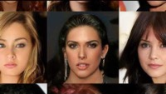
Generating Photorealistic Human Faces
Karras et al., 2018
Notes:
https://www.youtube.com/watch?v=XOxxPcy5Gr4

Slide 23
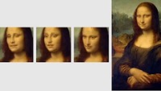
Living Portraits
Samsung AI Lab

Slide 24
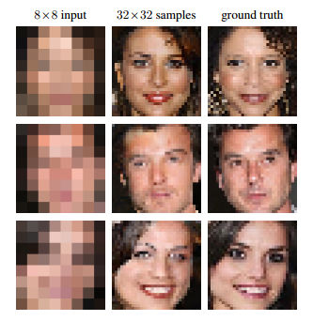
Image Enhancement and Super-Resolution
Uses a conditional generative model P( high res image | low res image)
Ledig et al., 2017

Slide 25

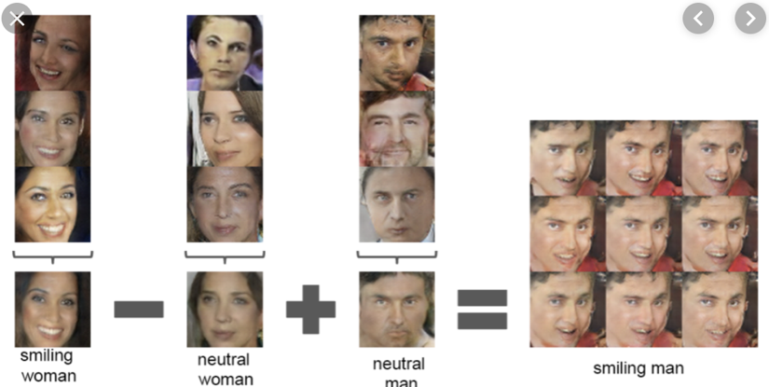
Representation Learning
Here, the generative models learns high-level concepts from data (similing, man, woman, etc.). We can use these to perform complex semantic manipulations over images.
Radford et al.

Slide 26


Generating Realistic Human Speech
Text to Speech
Generative model of speech signals
Parametric
Concatenative
WaveNet
Unconditional
Music
van den Oord et al, 2016c
Notes:
https://deepmind.com/blog/wavenet-generative-model-raw-audio/

Slide 27
Signal Processing and Signal Enhancement
Audio super-resolution using a conditional model P(high-res | low-res audio signal).
Low-res signal
High-res audio signal
Kuleshov et al., 2017

Slide 28
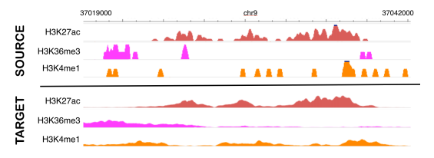
Signal Enhancement for Functional Genomics Assays
These ideas extend to other types of signals, e.g., genomic measurements (ChIP-Seq).
Cheap, low-resolution
experimental measurements
Accurate, high-resolution
experimental measurements
Birnbaum, Kuleshov et al., 2019

Slide 29
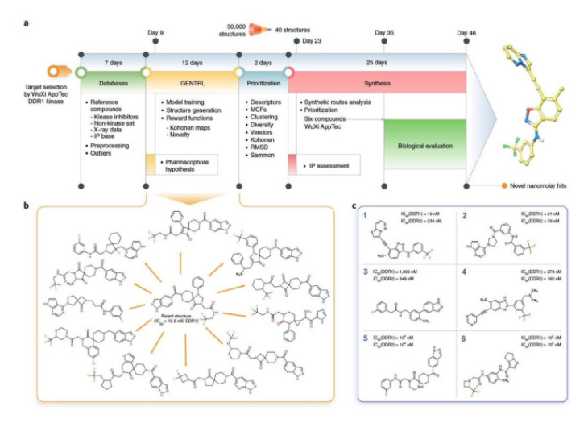
Generative Models for Drug Design
InSilico Medicine, 2020

Slide 30
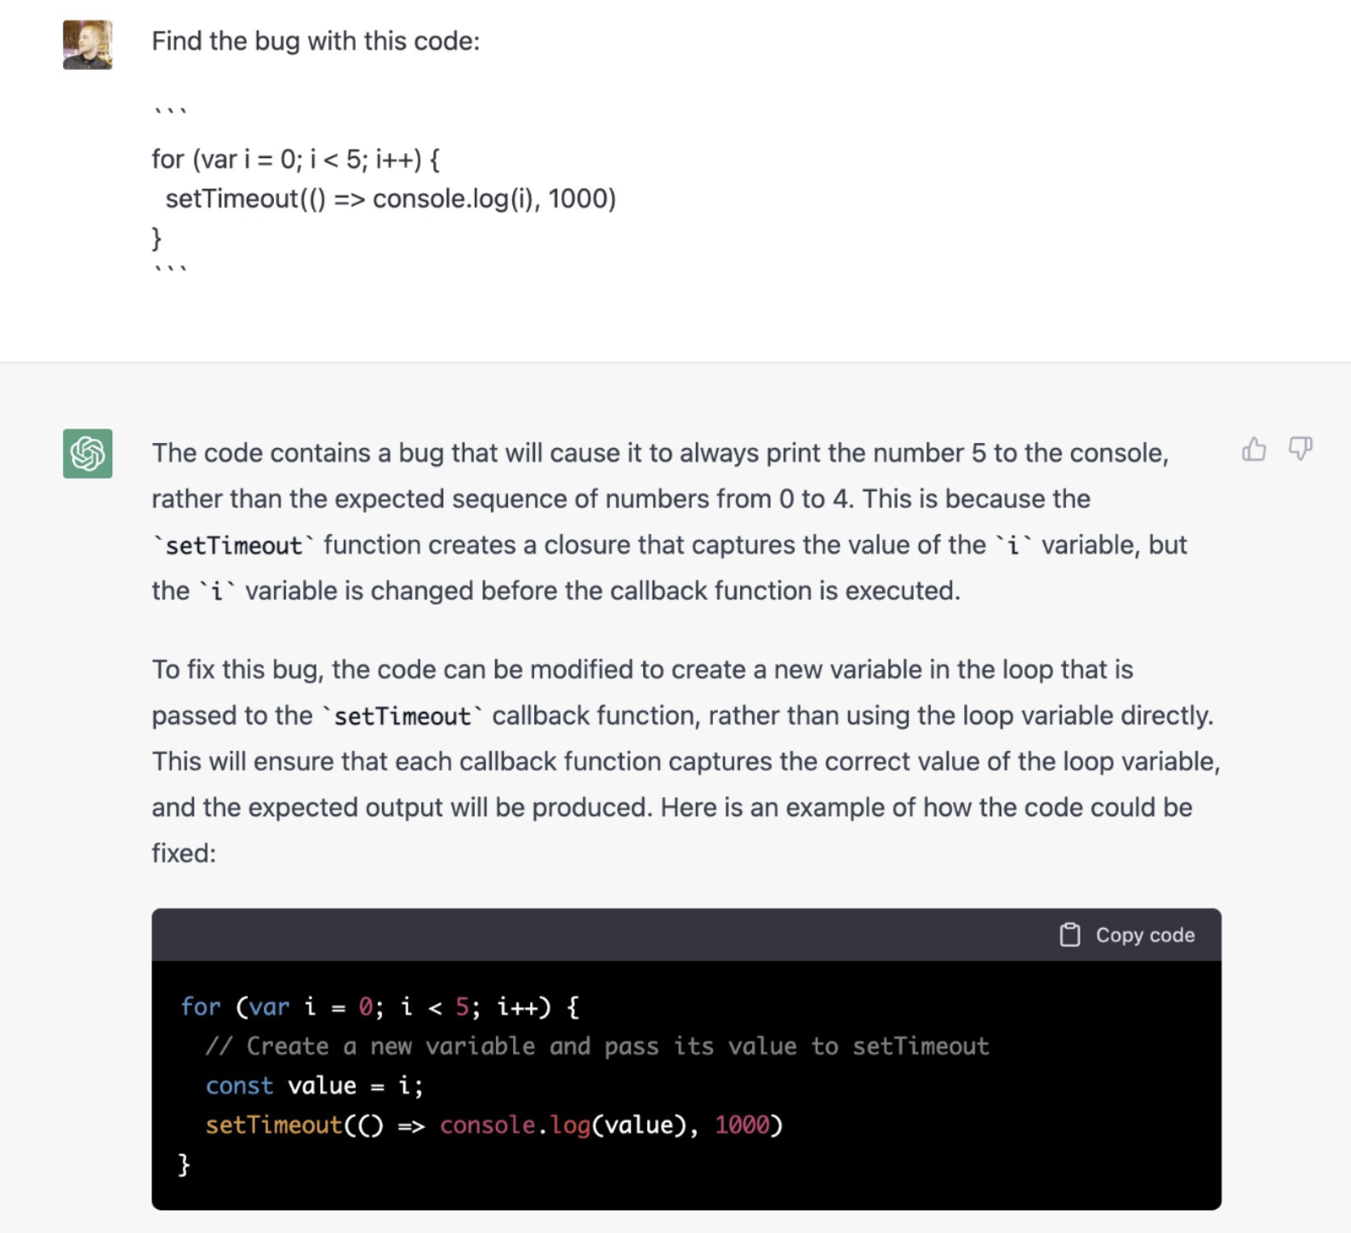
Language Generation

Slide 31
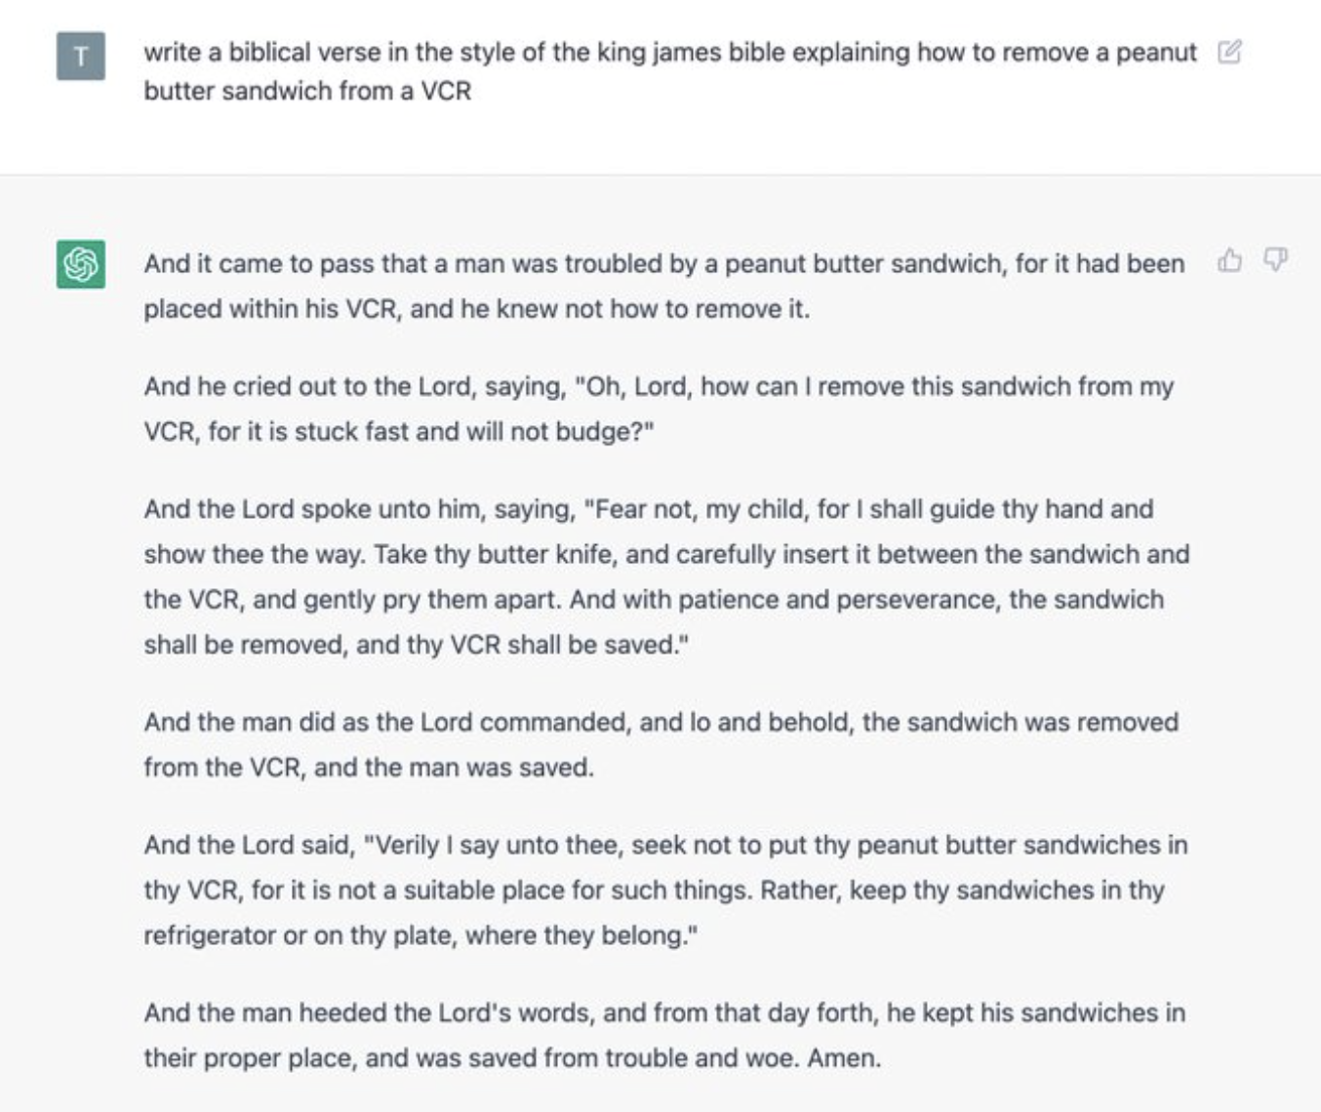

Slide 32
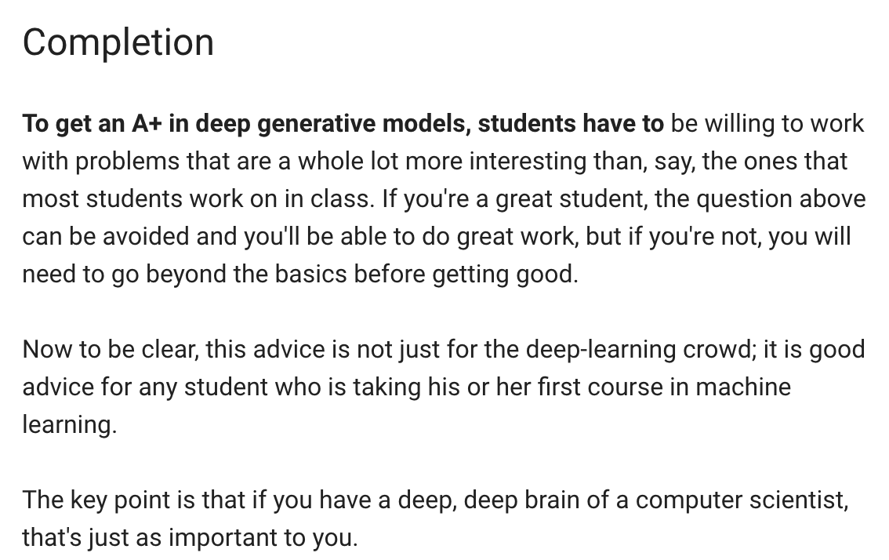
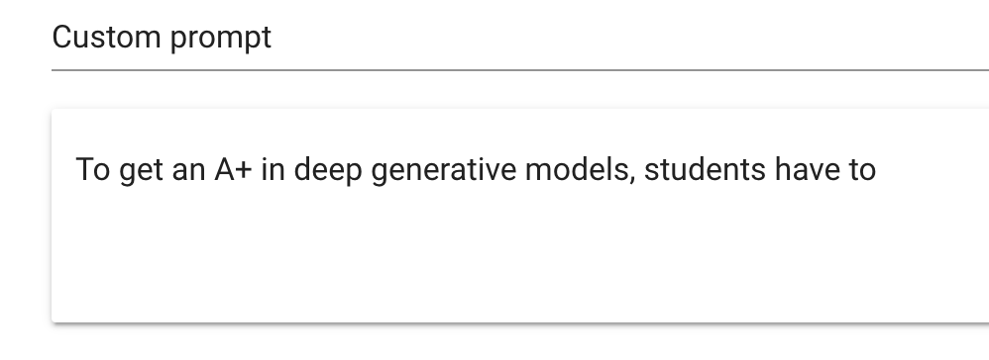
Language Generation
Radford et al., 2019
Demo from talktotransformer.com

Slide 33
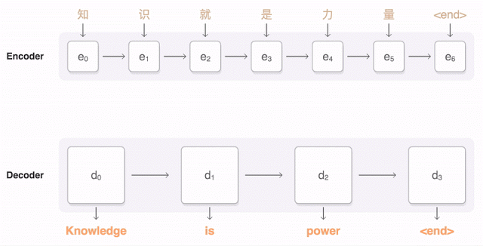
Machine Translation
Uses a conditional generative model P(English text | Chinese text).
Figure from Google AI research blog.

Slide 34

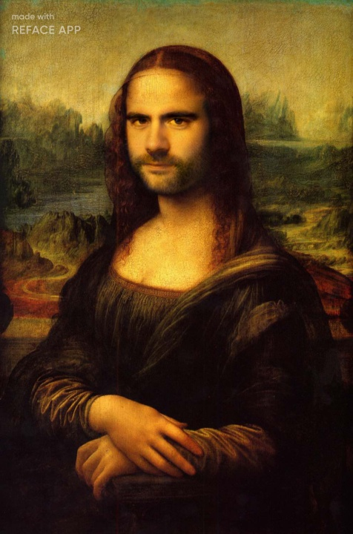

Deep Fakes & Face Swapping
Do you recognize anyone you know in these pictures?

Slide 35
DeepFakes / Face Swapping

Slide 36


DeepFakes
Which image is real?

Slide 37





DeepFakes
Neither!
No glasses!
No smile!

Slide 38

Image Translation
Horse-to-zebra translation using a model P(zebra images | horse images).
Zhu et al., 2017
Notes:
https://www.youtube.com/watch?time_continue=1&v=9reHvktowLY

Slide 39
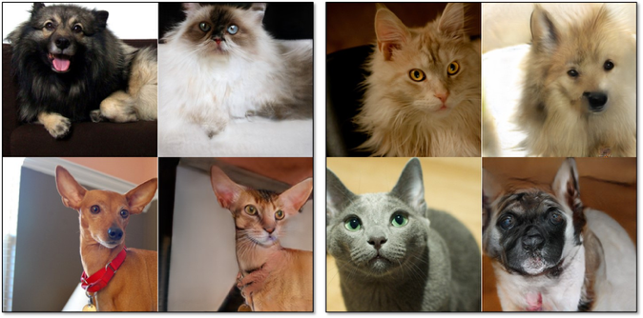
Image Translation
Dog-to-cat image translation using a model P(cat images | dog images)
Notes:
https://www.youtube.com/watch?time_continue=1&v=9reHvktowLY

Slide 40
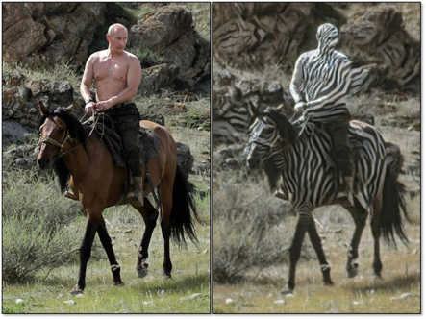
Failure Modes of Image Translation

Slide 41
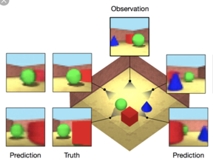
Decision-Making: Planning
An agent can use a generative model of the world to plan its actions.
Here, the model predicts the scene from different views. This helps the agent decide how to move in this simulated environement.

Slide 42
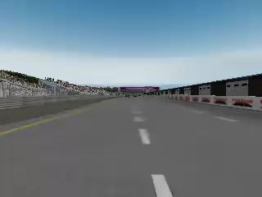
Decision-Making: Imitation Learning
We can also directly learn a model P( actions | past observations) from data:
The model predicts which actions (out of a high-dimensional set) to perform given a state.
We learn the model by comparing it to a distribution of actions from a human demonstrator.
Li et al., 2017

Slide 43
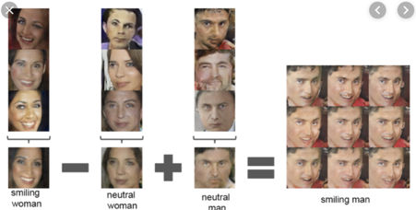
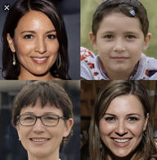
What Are Generative Models Useful For?
Generation and Manipulation
Super Resolution
Signal Processing
Signal Enhancement
Representation Learning
Style Transfer
Image Translation
Controlled generation
Decision-Making
Planning
Imitation Learning

Slide 44
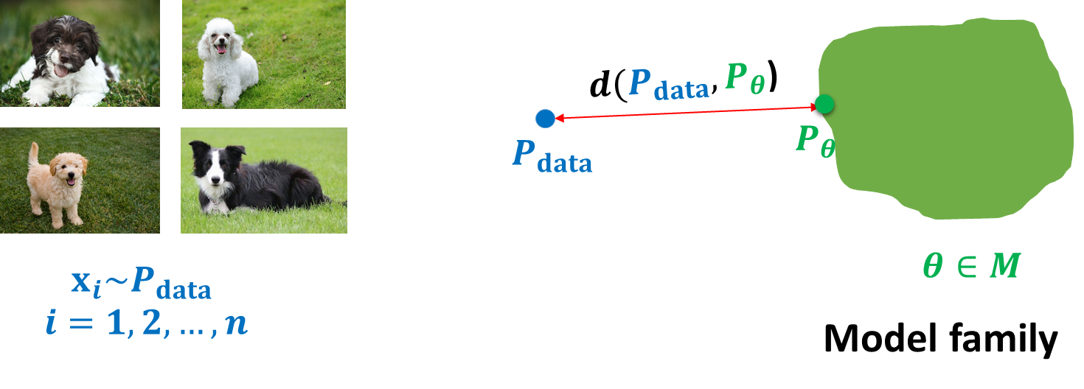

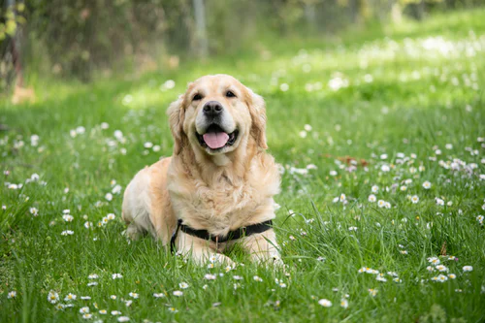


Roadmap and Key Challenges
Representation: how do we model the joint distribution of many random variables?
Need compact representation
Learning: what is the right way to compare probability distributions?
Inference: how do we invert the generation process (e.g., vision as inverse graphics)?
Unsupervised learning: recover high-level descriptions (features) from raw data
Notes:
Dog images from unsplash

Slide 45
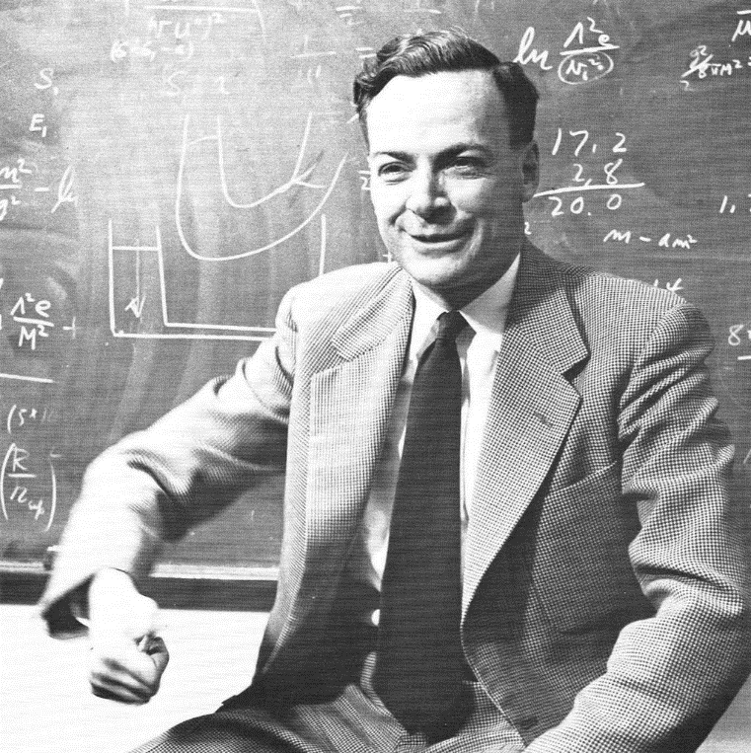
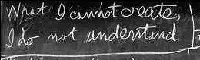
Generative Modeling As A Path To AI
Richard Feynman: “What I cannot create, I do not understand”
Generative Modeling: “What I understand, I can create”
Notes:
Https://commons.wikimedia.org/wiki/Category:Richard_Feynman#/media/File:Richard_Feynman_1959.png
http://archives-dc.library.caltech.edu/islandora/object/ct1%3A483

Slide 46
Next: Logistics

Slide 47
What Is The Course Like?
This course is about the probabilistic and algorithmic foundations of generative models.
We explain from first principles why and how each generative modeling algorithm works and we will use mathematics a lot.
Please make sure you have a solid mathematical background!
We focus less on specific implementation techniques (e.g., fast.ai style), but you will still implement most generative models in the homeworks and the course project.
You should have existing familiarity with building ML models in torch/tensorflow, or be willing to learn it.

Slide 48
Syllabus: Some Specific Topics
Introduction to the main families of generative models
Autoregressive models
Normalizing flows
Variational auto-encoders
Generative adversarial networks
Energy-based models
Learning and inference algorithms
Variational inference, two-sample tests, F-divergences
Specialized topics in generative modeling
Discreteness, graphs, evaluation, probabilistic programming
Cutting-edge research and papers (student presentations)

Slide 49
Syllabus
Fully observed likelihood-based models
Autoregressive
Flow-based models
Latent variable models
Variational learning
Inference amortization
Variational autoencoder
Implicit generative models
Two sample tests, embeddings, F-divergences
Generative Adversarial Networks
Learn about algorithms, theory & applications

Slide 50
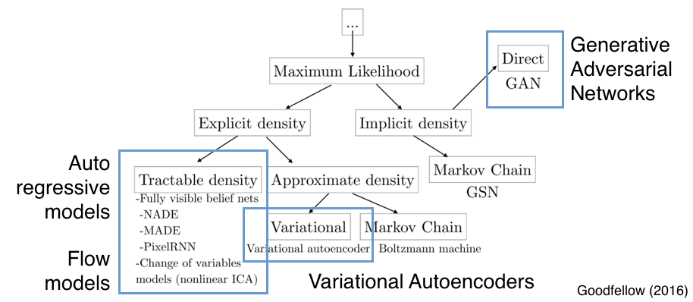
A Taxonomy of Generative Models

Slide 51
Prerequisites
Basic knowledge about machine learning from at least one of CS4780, CS4701, CS5785
Basic knowledge of probabilities and calculus:
Gradients, gradient-descent optimization, backpropagation
Random variables, independence, conditional independence
Bayes rule, chain rule, change of variables formulas
Basic knowledge of deep neural networks (CNNs, RNNs; CS5787).
Proficiency in some programming language (preferably Python) is required.

Slide 52
Logistics
Class webpage: https://canvas.cornell.edu/courses/50665
Online Lectures MW 1pm-2:15pm
Suggested Reading: Deep Learning by Ian Goodfellow, Yoshua Bengio, Aaron Courville. Online version available free here.
Lecture notes: https://deepgenerativemodels.github.io/notes/index.html
Office hours: 30 minutes after each lecture

Slide 53
Instruction Format
This semester, the course will follow a hybrid remote/in-person format:
The first several weeks of lectures will be given in a hybrid format
I will be lecturing from NYC and streaming to an Ithaca classroom & to Zoom.
Because of conference travel, several in-person lectures will be held remotely. You will be notified ahead of time via Canvas.
The last third of the course will consist of presentations of teams of students across Ithaca and NYC. I anticipate the presentations will be given remotely over Zoom.

Slide 54
Grading
Four homeworks (15% each):
First three: mix of conceptual and programming based questions
Homework 4: create your own homework! (stay tuned for details)
Presentation: 15%
Course Project: 25%
Proposal: 5%
Progress Report: 5%
Final Report: 15%

Slide 55
Presentations
Presentations can be done individually or in groups of two.
Should cover 1-2 research papers out of a list posted on the course website (See “Pages” tab in Canvas)
Expected length is 45 mins, followed by 15 mins discussion
Each team needs to write a review on two other papers.
Email the instructor to reserve presentation slots.
Presentations held in class in last third of the course
Requirements
Send presentation outline at least two weeks before talk
Send presentation slides at least two days before talk

Slide 56
Projects
Course projects will be done in groups of up to 3 students and can fall into one or more of the following categories:
Application of deep generative models on a novel task/dataset
Algorithmic improvements into the evaluation, learning and/or inference of deep generative models
Theoretical analysis of any aspect of existing deep generative models
Teaching staff will suggest possible projects

